Slide 1
بِسْمِ ٱللَّهِ ٱلرَّحْمَٰنِ ٱلرَّحِيمِ

Slide 2
Course: Web Designing
Institute: Corvit Systems Peshawar
Duration: 3-Month Web Designing & Development Course
5th class of web designing
HTML Forms & inputs

Slide 3
What we will learn today
By the end of this class, you will understand:
<form> tag (action, method)
Input types (text, email, number, password, date, file)
Labels
<textarea>
Checkbox & Radio buttons
Dropdown list <select>
Submit & Reset buttons
Basic validation attributes

Slide 4
Form Tag <form>
Used to collect user data.
Structure
<form action="submit.js" method="post"> <!-- form inputs will go here --> </form>
Attributes
action → Where the form data is sent
method → How data is sent
"get" → visible in URL
"post" → hidden from URL

Slide 5
Input Types
Text Input
<input type="text" placeholder="Enter your name">
Email Input
<input type="email" placeholder="Enter your email">
Number Input
<input type="number" placeholder="Enter your age">
Password Input
<input type="password" placeholder="Enter password">
Date Input
<input type="date">
File Input
<input type="file">

Slide 6
Labels
Links text with an input for better usability.
<label for="username">Name:</label>
<input type="text" id="username">
Textarea
Used for long text input.
<textarea rows="4" cols="30" placeholder="Write your message here"></textarea>
Checkbox
Used for multiple selections.
<input type="checkbox" id="html"> <label for="html">HTML</label>

Slide 7
Radio Buttons
Used for single selection.
<input type="radio" name="gender" value="male"> Male
<input type="radio" name="gender" value="female"> Female

Slide 8
Select Dropdown
<select>
<option>Select your city</option>
<option>Peshawar</option>
<option>Lahore</option>
<option>Karachi</option>
</select>

Slide 9
Submit & Reset Buttons
<input type="submit" value="Submit Form">
<input type="reset" value="Reset Form">

Slide 10
Basic Validation Attributes
required
<input type="text" required>
min / max
<input type="number" min="1" max="10">
maxlength
<input type="text" maxlength="20">

Slide 11
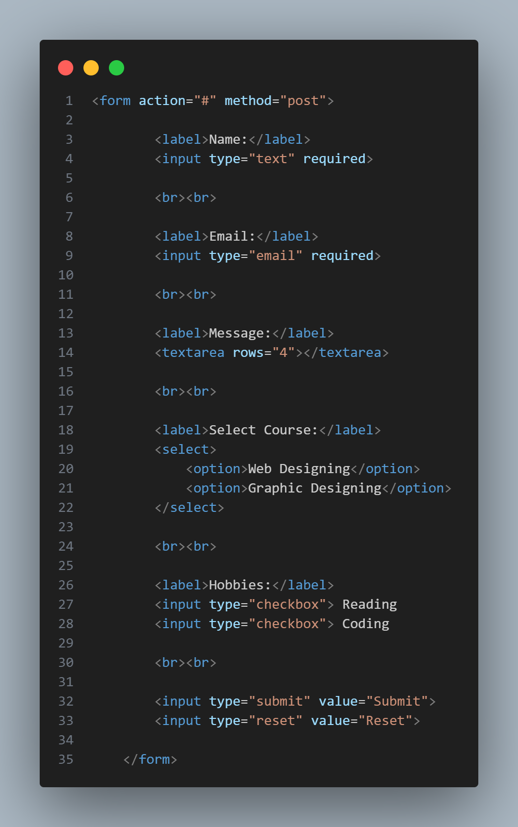
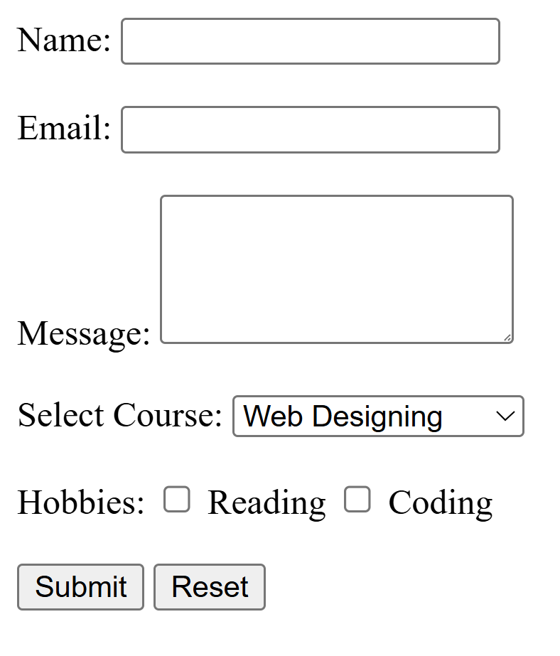
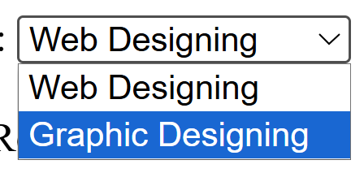
Complete Practical Form Example

Slide 12
Summary of today Class
Today we covered:
Form tag (action + method)
Input types
Labels & textarea
Checkbox and radio
Dropdown
Submit and reset buttons
Basic validation attributes
Next Class → We will learn CSS

